Slide 1
IoT Enabling Technologies
Farzana Akter
Lecturer, Department of ICT(IOT Program)
BANGABANDHU SHEIKH MUJIBUR RAHMAN DIGITAL UNIVERSITY, BANGLADESH

Slide 2
IoT is enabled by several technologies including :
Wireless sensor network.
Cloud computing.
Big data analytics.
Embedded Systems.

Slide 3
Sensors
First we need to know about sensors.
Sensors are sophisticated devices that are frequently used to detect and respond to electrical or optical signals.
A Sensor converts the physical parameter (for example: temperature, blood pressure, humidity, speed, etc.) into a signal which can be measured electrically.

Slide 4
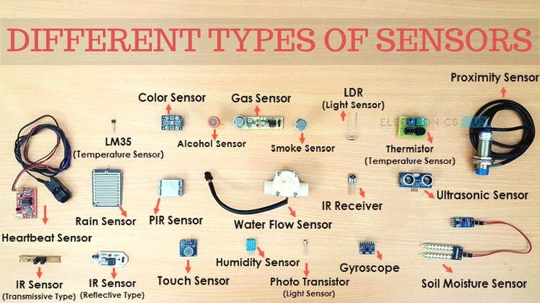

Slide 5
Types of sensors
Active sensor need an external power supply(like battery) to work.
Example : Blood pressure sensor, temperature sensor, ultrasonic sensors etc.
Like ultrasonic sensors power is needed to generate and transmit
the ultra sound waves.
Passive sensor use its own energy to work. Example : PIR Like an infrared camera or PIR sensor uses external heat energy to capture images.

Slide 6
Types of sensors
Analog Sensors produce an analog output i.e. a continuous output signal with
respect to the quantity being measured. Ex: Temperature sensor, Light Sensor etc.
Digital Sensors, in contrast to Analog Sensors, work with discrete or digital
data. The data in digital sensors, which is used for conversion and transmission, is
digital in nature. Ex: Led Sensor, Temperature sensor.
For more : https://www.instructables.com/
https://www.instructables.com/id/Arduino-37-in-1-Sensors-Kit-Explained/

Slide 7
Sensor Networks
A sensor network comprises a group of tiny, typically battery-powered devices and wireless infrastructure that monitor and record conditions in any number of environments.
The sensor network connects to the Internet, an enterprise WAN or LAN, or a specialized industrial network so that collected data can be transmitted to back-end systems for analysis and used in applications.

Slide 8
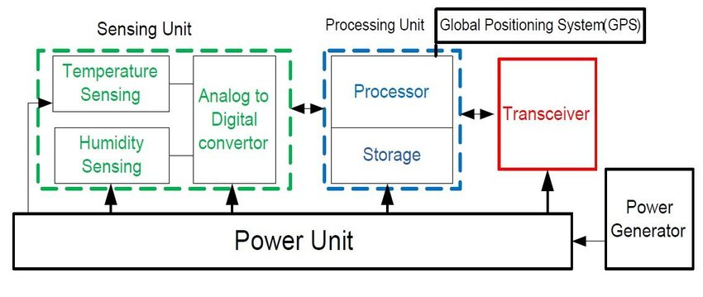

Slide 9
Sensing Unit :
It is usually composed of two subunits: sensors and Analog-to-Digital convertors (ADC’s).
Analog signals produced by sensors based on observed phenomenon are converted to digital signals by ADC, and then fed into processing unit.
Processing Unit :
The core of the wireless sensor node is the processing unit, usually a microprocessor with a limited amount of memory. The processing unit is connected to the sensors via one or more Analog to Digital Converters (ADCs).

Slide 10
Power Unit:
The power unit and the power generator are a key element in the sensor structure. The power unit is responsible to provide the electrical power needed by the other units in the system.
Location finding system:
Specific nodes may integrate a location finding system that helps the node to discover its position, relative to its neighbors or global. This unit is often embedded on the transceiver module and requires the use of specific algorithms by the processing unit, depending on the adopted localization techniques

Slide 11
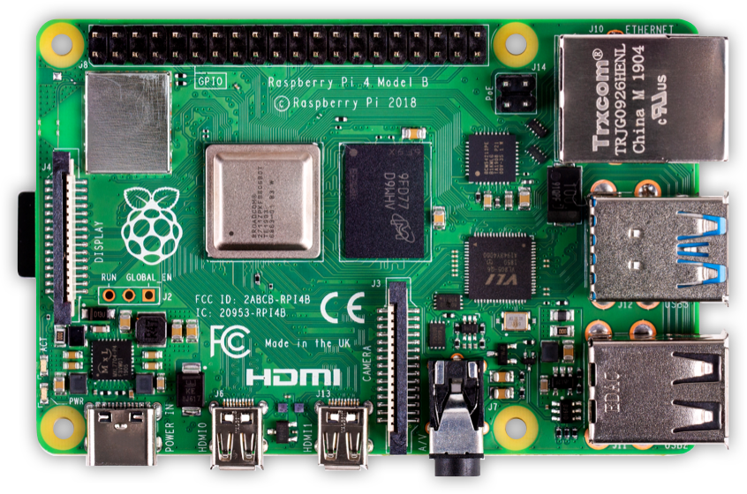
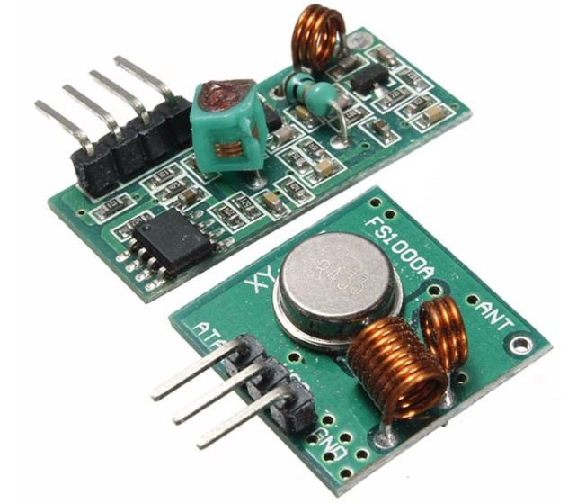
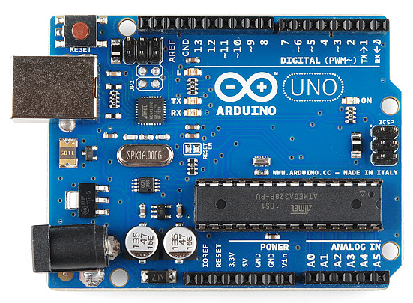

Slide 12
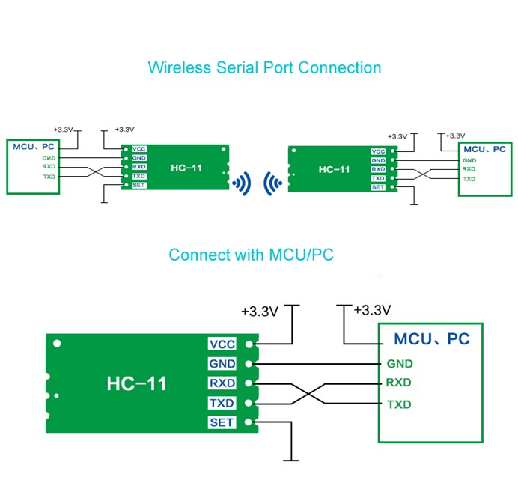
Transceiver:
transmitter-receiver, a device that both transmits and receives analog or digital signals. RF (Radio Frequency) Technology, satellite, wired connections/optical fiber etc.

Slide 13
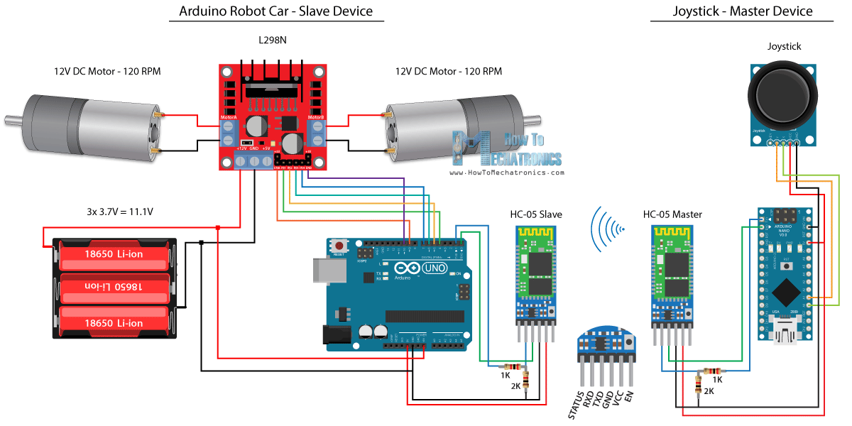

Slide 14
What is Wireless Sensor Networks?
WSN consists of multiple sensors to monitor physical or environmental conditions.
Typically a wireless sensor network contains hundreds of thousands of sensor nodes.
It can sense temperature, sound, pressure, motion, humidity etc. and can pass these data through the wireless media or network to a main location or base station where the data can be observed and analyzed.

Slide 15
Wireless Sensor Networks
The sensor data is transmitted to network coordinator which is heart of the wireless personal area network.
Coordinators collects data from all nodes and acts as gateway that connects WSN to internet.
Routers route the data packets from end nodes to coordinators.

Slide 16
Types of Wireless Networks
Basically, there are five types of wireless networks:
Wireless PAN
Wireless LAN
Wireless MAN
Wireless WAN
Global Area Network

Slide 17
Environmental Application
(air/water pollution, fire detection, soil moisture monitoring, weather monitoring etc.)
Health Application
(monitor patient’s data)
Application of WSN
Home Application
(Temperature Control, Motion Detection, lighting control , security alarm etc.)
Security & Surveillance Application
(enemy tracking, target detection etc.)

Slide 18
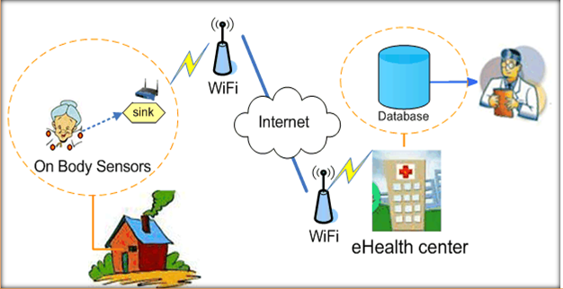

Slide 19
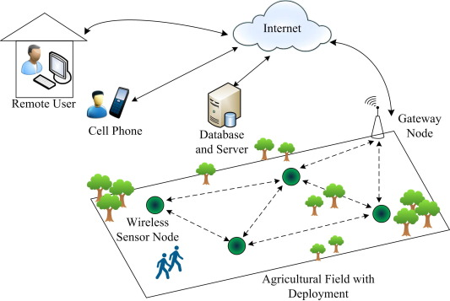

Slide 20


Slide 21
low/zero touch interaction for simple tasks such as
>> turning off lights
>>opening the door/windows etc.
Contactless Services
>>MicroMultiCopter-Thermal camera-equipped drones
>>Disinfecting robots
Smart Devices
>> Smart wristband

Slide 22
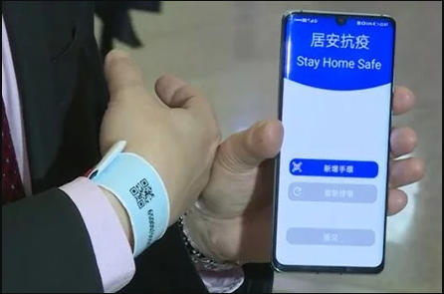

Slide 23
Protocols
ZigBee communication protocol :
ZigBee is newly developed technology that works on IEEE standard 802.15.4, which can be used in the wireless sensor network (WSN).
The low data rates, low power consumption, low cost are main features of ZigBee.
The ZigBee technology is designed to carry small amounts of data over a short distance while consuming very little power.
It is a short-range communication standard like Bluetooth and Wi-Fi, covering range of 10 to 100 meters.

Slide 24
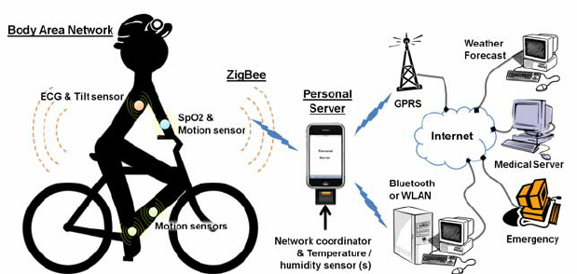

Slide 25
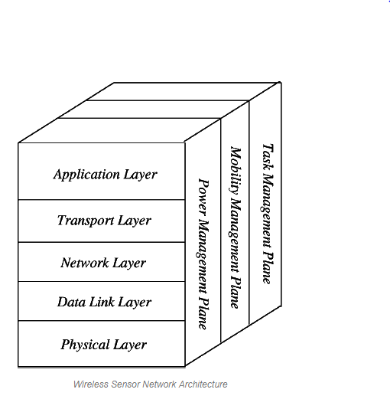
Wireless Sensor Network Architecture
The most common WSN architecture follows the OSI architecture Model.
The architecture of the WSN includes five layers(application, transport, network, data link & physical layer) and three cross layers(power management, mobility management, and task management).

Slide 26
Online Assessment-2
Write short note on :
three cross layers:
power management
mobility management
and task management).
Soft copy submission Date : 9.5.2020

Slide 27
Application Layer
It provides necessary interfaces to the user to interact with the physical world through the WSN. This layer makes hardware and software of the lowest layer transparent to the end-user.
Transport Layer
The function of the transport layer is to deliver congestion avoidance and reliability using protocols. There are some popular protocols in the transport layer namely STCP (Sensor Transmission Control Protocol), PORT (Price-Oriented Reliable Transport Protocol and PSFQ (pump slow fetch quick). The transport layer is exactly needed when a system is planned to contact other networks.
Network Layer
The main function of the network layer is routing supplied by the transport layer, specific multi-hop wireless routing protocols between sensor nodes and sink.
The most popular routing protocol is LEACH (The Low-Energy Adaptive Clustering Hierarchy).This divides the network into clusters and randomly selects the cluster head for it to do the routing job from cluster to the sink after carrying out data aggregation.

Slide 28
Data Link Layer
The data link layer is liable for multiplexing data frame detection, data streams, MAC, & error control, confirm the reliability of point–point (or) point– multipoint.
Physical Layer
Can provide an interface to transmit a stream of bits over physical medium. Responsible for frequency selection, carrier frequency generation, signal detection, Modulation and data encryption. IEEE 802.15.4: proposed as standard for low rate personal area and WSN with low: cost, complexity, power consumption, range of communication to maximize battery life.
For more : Alkhatib, A. A. A., & Baicher, G. S. (2012). Wireless sensor network architecture. In 2012 International Conference on Computer Networks and Communication Systems (CNCS 2012).

Slide 29
Classification of WSNs
Terrestrial WSNs
Military application
Underground WSNs
Monitor underground condition
Underwater WSNs
Water quality monitoring
Multi-media WSNs
Public security application
Mobile WSNs
Mobile application

Slide 30
Terrestrial WSN
* It consists of numerous tiny sensor nodes that communicates with the base station .
* The sensor nodes are dropped over a region where some phenomenon is to be
monitored. It can be :
* structured(pre-planned) or unstructured(ad hoc)
* The energy conservation of terrestrial WSNs is achieved by using multi-hop optimal routing ,
short transmission range, eliminating data redundancy, in-network data aggregation, minimizing
delay etc.
* Challenges : the battery power is limited which is equipped with secondary power cells as
solar cells.
* Example : Enemy tracking, surveillances, geo-fencing of gas or oil pipelines etc.

Slide 31
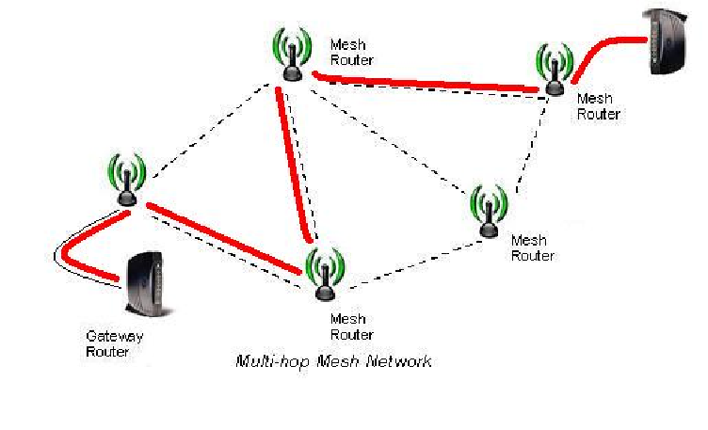
Additional Notes:

Slide 32
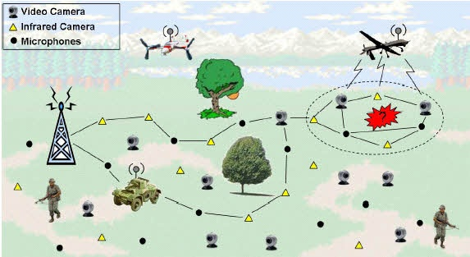

Slide 33
Additional Notes:
Night vision vs Infrared cameras
1.Night vision detects visible light while infrared detects radiated heat 2. Night vision needs a little amount of light while infrared doesn’t 3. Infrared is better for camouflaged targets than night vision 4. Night vision can be counteracted by bright light while infracted can counteracted by cooling
For more : https://reductionrevolution.com.au/blogs/news-reviews/thermal-camera-infrared-scanner-uses

Slide 34
Underground WSNs
*The underground WSNs networks consist of a number of sensor nodes that are hidden in the ground to monitor underground conditions.
* To relay information from the sensor nodes to the base station(act as a gateway to forward data from
the WSN on to a server.), additional sink nodes(acts as a gateway or interface between the sensor
node and the base station) are located above the ground.
* The underground wireless sensor networks that equipped with a limited battery power are difficult to
recharge. Additionally, the underground environment makes wireless communication a challenge due
to high level of attenuation and signal loss.
* The underground wireless sensor networks are more expensive than the terrestrial WSNs in terms of
deployment, maintenance, and equipment cost considerations and careful planning.

Slide 35
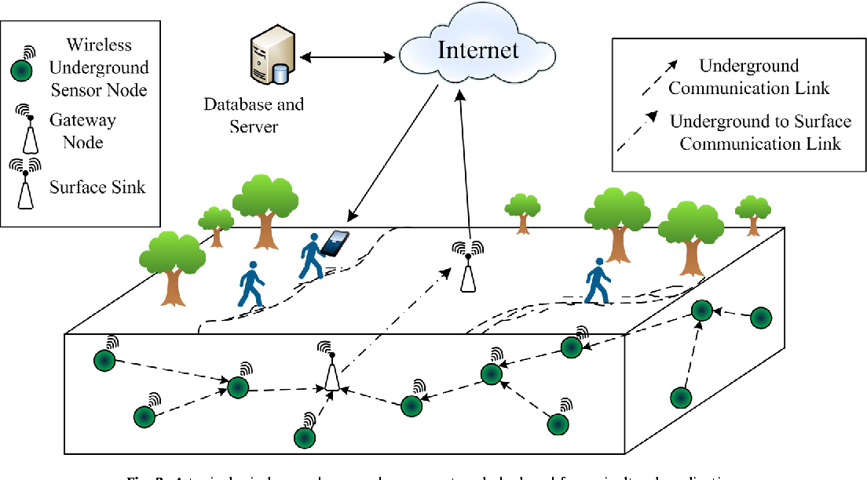

Slide 36
Application
It monitors soil water and mineral content for irrigation.
Monitoring soli movement for earthquake(by seismometer), landslides(by fibre-optic sensors,
accelerometer etc.)prediction.
Monitoring soil conditions for sports field maintenance etc.

Slide 37
Underwater WSNs
* More than 70% of the earth is occupied with water. These networks consist of a number of
sensor nodes and vehicles deployed under water. Autonomous underwater vehicles are used
for gathering data from these sensor nodes. A challenge of underwater communication is a
long propagation delay, and bandwidth and sensor failures.
* Under water WSNs are equipped with a limited battery that cannot be recharged or
replaced. The issue of energy conservation for under water WSNs involves the development
of underwater communication and networking techniques.

Slide 38
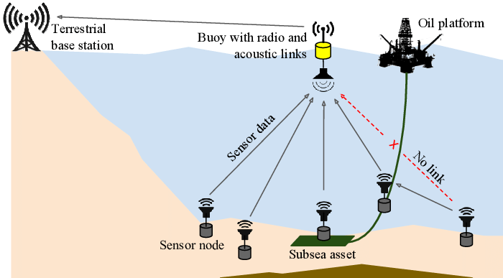

Slide 39
Application
Seismic Monitoring for oil extraction from underwater fields.
Finding submarine links.
Finding lost sink urban communities.

Slide 40
Multi-media WSNs
* is a network of wirelessly interconnected sensor nodes equipped with multimedia devices, such as cameras and microphones, and capable to retrieve video and audio streams, still images, as well as scalar sensor data.
*These nodes are interconnected with each other over a wireless connection for data compression, data retrieval and correlation.
* The challenges with the multimedia WSN include high energy consumption, high bandwidth requirements, data processing and compressing techniques. In addition to this, multimedia contents require high bandwidth for the contents to be delivered properly and easily.
* Example : indoor/outdoor surveillance systems, traffic monitoring and control systems for urban and sub-urban areas, systems supporting telemedicine, attendance to disable and elderly people, environment monitoring, localization and recognition of services and users, monitoring and control of manufacturing processes in industry

Slide 41
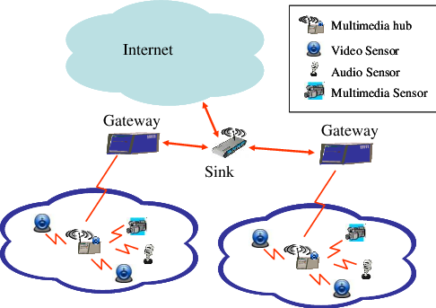

Slide 42
Mobile WSNs
* A wireless sensor network (WSN) in which the sensor nodes are mobile.
*Commonly, the nodes consist of a radio transceiver and a microcontroller powered by a battery, as well as some kind of sensor for detecting light, heat, humidity, temperature, etc.
* The mobile wireless sensor networks are much more versatile than the static sensor networks. The advantages of MWSN over the static wireless sensor networks include better and improved coverage, better energy efficiency, superior channel capacity, and so on .
* Applications for mobile WSN are environment monitoring, target tracking, search and rescue and real-time monitoring of hazardous

Slide 43
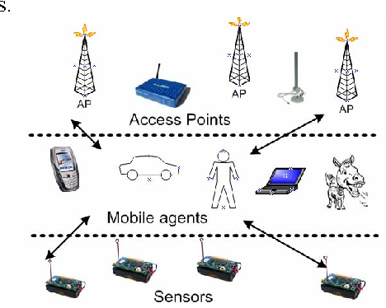

Slide 44
Limitations of Wireless Sensor Networks
Possess very little storage capacity – a few hundred kilobytes
Possess modest processing power-8MHz
Works in short communication range – consumes a lot of power
Requires minimal energy – constrains protocols
Have batteries with a finite life time
Passive devices provide little energy

Slide 45
Cloud Computing
In the simplest terms, cloud computing means storing and accessing data and programs over the Internet instead of your computer's hard drive. The cloud is just a metaphor for the Internet.
Cloud computing is the delivery of different services through the Internet, including data storage, servers, databases, networking, and software.
Cloud-based storage makes it possible to save files to a remote database and retrieve them on demand.

Slide 46
offer facilities
request response request response request response
Cloud Provider
Facilities
SaaS+PaaS+IaaS
Cloud User 3
Desktop
Cloud User 1
Mobile Phone
Cloud User 2
Laptop

Slide 47
Common Cloud Examples
Cloud computing for storage :
Microsoft OneDrive,
Google Drive etc.
Web-based/Cloud apps :
Office Online,
Google Docs, Google Sheets, and Google Slides
Gmail,
Google Calendar,
Google Maps and so on.

Slide 48
Types of Cloud Computing
Cloud computing is not a single piece of technology like a microchip or a cellphone. Rather, it's a system primarily comprised of three services:
Software-as-a-service(SaaS).
Infrastructure-as-a-service (IaaS).
Platform-as-a-service (PaaS).

Slide 49
Software-as-a-service(SaaS):
SaaS platforms make software available to end users over the internet, usually for a pay-as-you-go or on-demand subscription fee.
With SaaS, you don’t need to install and run software applications on your computer (or any computer).
Everything is available over the internet when you log in to your account online.
You can usually access the software from any device, anytime (as long as there is an internet connection).
The most popular SaaS applications for business are Google’s G Suite and Microsoft’s Office etc.

Slide 50
Platform-as-a-service (PaaS)
A service provider offers access to a cloud-based environment in which users(developers) can build and deliver applications.
In addition to storage and other computing resources, users are able to use a suite of prebuilt tools to develop, customize and test their own applications.
PaaS shares some similarities with SaaS, the primary difference being that instead of delivering software online, it is actually a platform for creating software that is delivered via the Internet. This model includes platforms like Force.com, Google App Engine etc.

Slide 51
Infrastructure-as-a-service (IaaS) :
A vendor provides clients(system admin) pay-as-you-go access to storage, networking, servers and other computing resources in the cloud.
Clients can avoid the need to purchase software or servers.
Popular examples of the IaaS system include IBM Cloud and Microsoft Azure.

Slide 52
Server | Storage | Network | OS | DB | App Server | Config App Server | Application
IaaS
20% time savings
Infrastructure | OS | DB | App Server | Config App Server | Application
PaaS
80% time savings
Infrastructure | Platform | Application
SaaS
95% time savings
Infrastructure | Platform | Software

Slide 53
Big Data
Collection of data whose volume, velocity or variety is too large and
difficult to store, manage, process and analyze the data using
traditional databases.
• It involves data cleansing, processing and visualization.
• Lots of data is being collected and warehoused
>Web data, e-commerce
>Bank/Credit Card transactions
>Social Network

Slide 54
THANK YOU

